Slide 1

Ching-Wen Chen
Translated from Chinese (Simplified) to English - www.onlinedoctranslator.com
Social Commerce and Influencer Economy
Using UGC (User-Generated Content) for marketing is a new trend.
➜ Using Xiaohongshu and SHEIN as examples.

Slide 2
Unit Outline
1.Definition and Development of Social Commerce
2.Internet celebrities andKOLInfluence in e-commerce
3.Social Business Platform and Case Studies
4.Social BusinessRepresentative platform: Xiaohongshu
5.Which social media platforms?At the same timeCombining social interaction and online shoppingFunction?
6.Current trends in social media e-commerce: traffic diversion
7.User-generated content in social commerce (UGC）
8.How to useUGCConduct marketing

Slide 3
1.Social Commerce
Definition and development

Slide 4
Definition of Social Commerce
Social Commerce refers to commercial activities conducted through social media platforms, combining social interaction and online shopping.
Consumers can discover, purchase and recommend products through recommendations, comments and sharing on social media. This business model leverages the influence of social networks to make the shopping experience more interactive and personalized.

Slide 5
The Development of Social Commerce
Early stage:
The prototype of social commerce appeared in the early development of social media, when consumers began to use the platform to make product recommendations and reviews.
Social media platforms integrate shopping functions:
With the evolution of social media, platforms have gradually integrated shopping functions, such as Facebook's Marketplace and Instagram's shopping tags.
The rise of live streaming sales:
Especially in China, live streaming has become an important form of social commerce, where influencers (such as internet celebrities and KOLs) can promote and sell products through real-time interaction.
Globalization and Diversification:
Social commerce has become a global trend that is not limited to traditional e-commerce platforms, but also includes commercial applications of instant messaging tools such as WhatsApp and WeChat.

Slide 6
The Influence of Influencers and KOLs (Key Opinion Leaders)
in E-commerce

Slide 7
Definition of Internet Influencers and KOLs
Influencers:
An influencer is usually an individual who has a large following on social media platforms and is able to influence others' purchasing decisions.
Key Opinion Leaders (KOL):
KOL refers to people with expertise and influence in a specific field, whose opinions have a significant impact on the target audience.

Slide 8
The sources of influence of Internet Influencers and KOLs
Fan base:
Internet celebrities and KOLs usually have a large number of loyal fans, and their recommendations and comments can directly influence their fans' purchasing decisions.
Content creation ability:
High-quality content is the key to attracting fans and maintaining influence. Internet celebrities and KOLs establish deep emotional connections with fans through creative content.
Trust and Authenticity:
Fans generally believe that recommendations from influencers and KOLs are authentic and credible because they believe these opinion leaders make recommendations based on their personal experience and expertise.

Slide 9
The role of influencers and KOLs in e-commerce
Product Promotion:
Through social media platforms, influencers and KOLs can promote products to a large number of fans, quickly increasing brand awareness and sales.
Brand image building:
KOL recommendations can help brands build a high-quality and professional image and enhance their market competitiveness.
Promotion of marketing activities:
By collaborating with influencers and KOLs, brands can design more attractive marketing activities, such as lucky draws, discount code promotions, etc., to increase engagement.

Slide 10
3.Social Business Platform and Case Studies

Slide 11
Mainstream social commerce platforms
Instagram:
Instagram provides a wealth of business tools, such as shopping tags and brand cooperation management tools, to help businesses sell and promote directly on the platform.
Facebook:
Facebook Marketplace and Facebook Shops enable businesses to display and sell products directly on the platform, while using Facebook's advertising system to accurately deliver ads.
WeChat:
WeChat combines social, payment and e-commerce functions to form a unique social commerce ecosystem, which has a strong influence in the Chinese market.
TikTok:
TikTok has quickly become an important shopping channel for the younger generation of consumers through short video content and live streaming functions. Brands can promote their products by collaborating with creators.
Little Red Book (Xiaohongshu):
Xiaohongshu combines social media and e-commerce functions through user-generated content (UGC) to recommend and share products, forming a highly trusted social shopping platform. Brands can set up official accounts on Xiaohongshu and directly interact with consumers and sell products through seeding notes, live broadcasts and e-commerce portals, which has a strong influence especially among young Chinese consumers.

Slide 12
4.Social Business Representative platform: Xiaohongshu

Slide 13
Mainstream social commerce platforms
Little Red Book (Xiaohongshu):
Xiaohongshu has combinedSocial Media and E-CommerceFunction,
pass throughUser-generated content (UGC）To proceedProduct recommendations and sharing,
Formed a highly trusted social shopping platform.
Brands can create official accounts on Xiaohongshu.
pass throughPlanting notes,
live streaming
E-commerce portal
Interact and sell products directly to consumers,
Especially inYoung Chinese ConsumersIt has a strong influence in the

Slide 14
Chinese version IG: Xiaohongshu
Little Red Book
Well-known in ChinaOnline shopping and social networkingAPP
Some people compare it to "Chinese versionInstagram"
In addition to well-known e-commercePOBesides the article, ordinary people can also share "good things" here.
How it worksandInstagramalmost
Can post(Xiaohongshu calls itNotes),
Limited time dynamic(Xiaohongshu saysRelease moment),
The interface is alsoPictures and VideosFor the Lord,
AlsoLike, share, commentBasic social content

Slide 15
Chinese version IG: Xiaohongshu
Users can
Share beauty and outfits; or simply record the big and small things in life.
Currently in China, Xiaohongshu is
NowadaysGirlthinkA must-have search platform for tracking popular information,
There are quite a few peopleTake Xiaohongshu asGoogle, BaiduSearch engines such as
whenWhen you want to shop or have questions about fashion,HabitFirst use Xiaohongshu to search,
Direct useAPPYou can purchase items from the "Mall" in the app.

Slide 16
Chinese versionIG: Xiaohongshu
Users can
Share beauty and outfits; or simply record the big and small things in life.
Currently in China, Xiaohongshu is
NowadaysGirlthinkA must-have search platform for tracking popular information,
There are quite a few peopleTake Xiaohongshu asGoogle, BaiduSearch engines such as
whenWhen you want to shop or have questions about fashion,HabitFirst use Xiaohongshu to search,
Direct useAPPYou can purchase items from the "Mall" in the app.

Slide 17
Why Xiaohongshu is so popular? How does it differ from Instagram?
SimilarFunction:
The interface is mainly based on pictures and videos.
Release Moment Enrichment Filter(SimilarIG story),
Post, send private messages, like, share and other social functions

Slide 18
Why Xiaohongshu is so popular? How does it differ from Instagram?
Analysis of the differences between the two:
1.Newly registered users can choose content based on their interests
The first time users browseArticles, and the system will recommend more posts on related topics based on the algorithm to increase user stickiness.
The topics include: hair styles, nail art, makeup, food and other popular trends among young people, as well as technology such as digital technology,3Cwait
2.Recommended posts are not limited to a single topic, and can automatically extend similar content

Slide 19
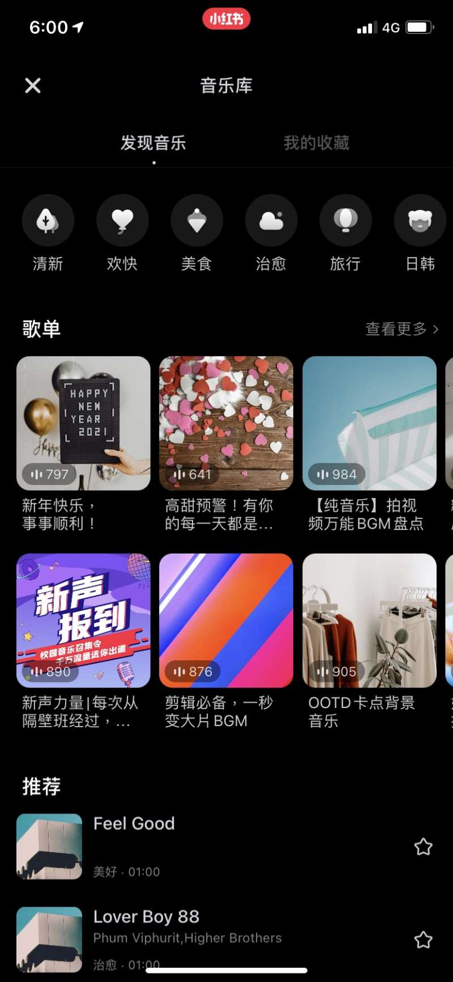
Why Xiaohongshu is so popular? How does it differ from Instagram?
3.Built-in popular music library and exquisite album templates, allowing users to apply them directly

Slide 20
Why Xiaohongshu is so popular? How does it differ from Instagram?
4.Tutorial-focused videosContent, influencer experts in one minute "Guaranteed teaching"
Often you see things like "Hair braiding tutorial for beginners"、"Guaranteed teaching"This type of video content.
The photographer often plays the role of a teacher or professional.Share with your audience in the simplest and most interesting way within one minute,
Helps to cultivate "Internet celebrity experts" in this field

Slide 21
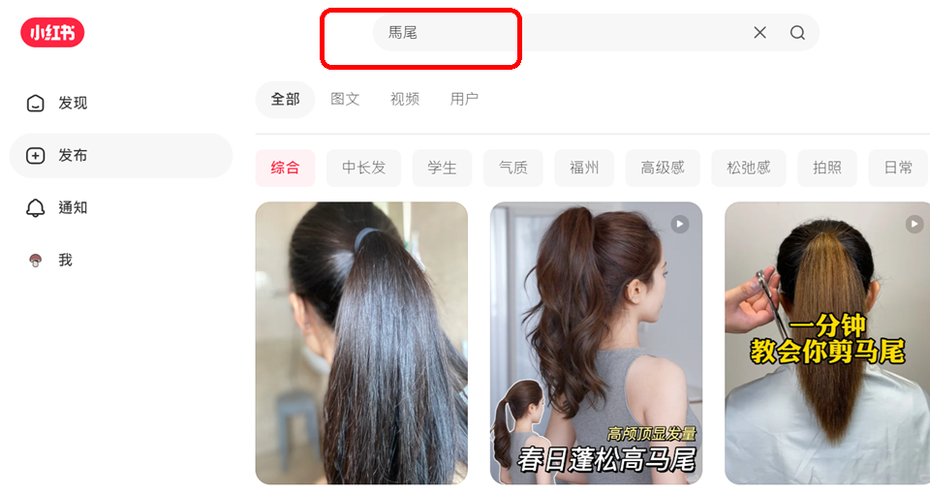
In the search bar, enter: ponytail

Slide 22
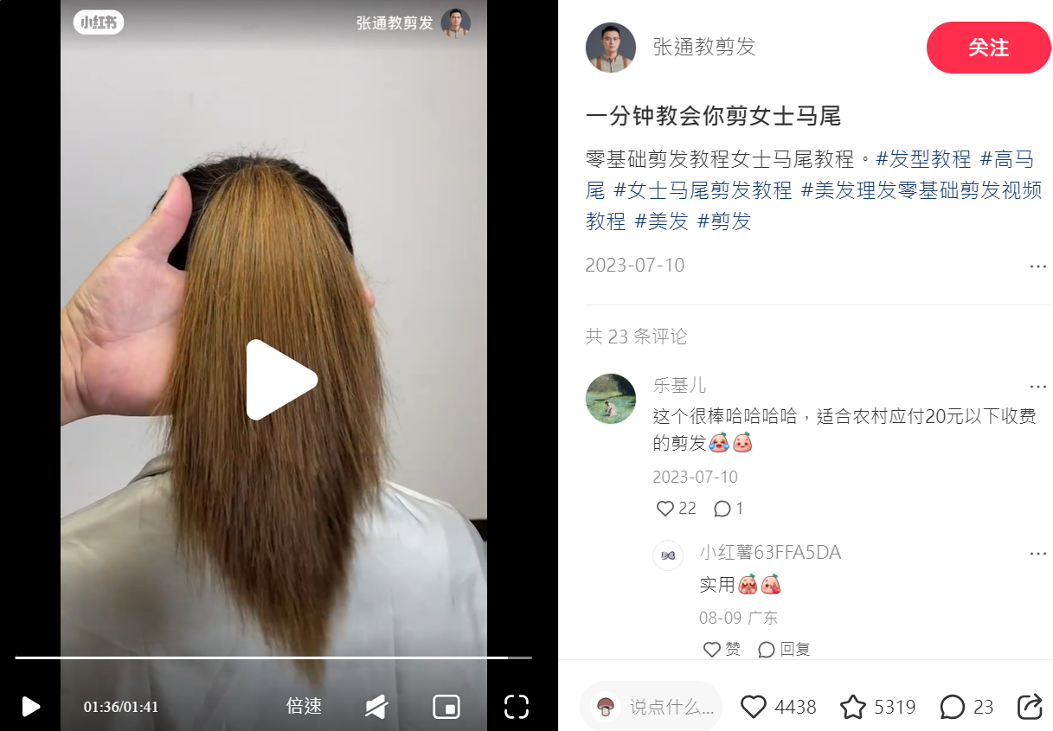

Slide 23
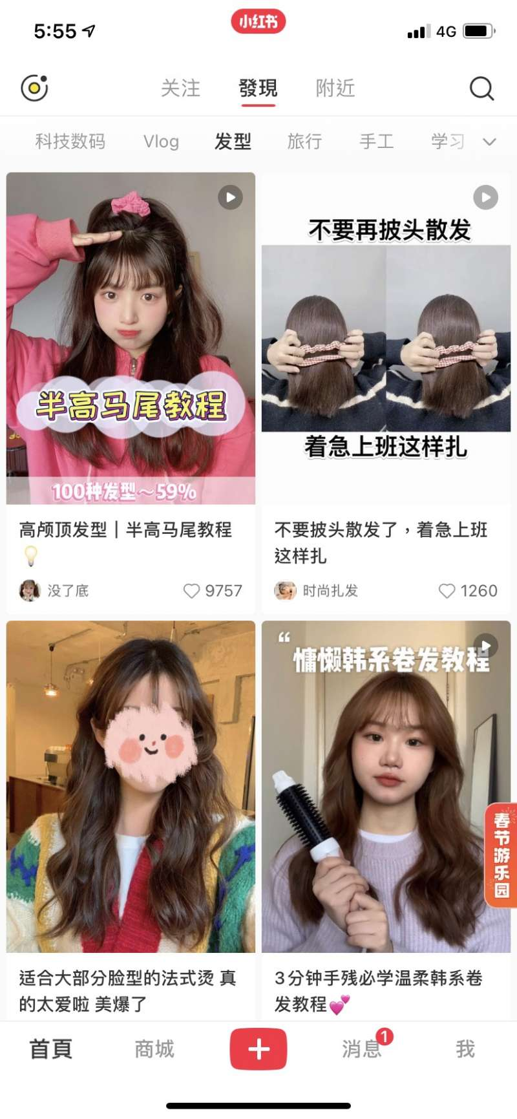
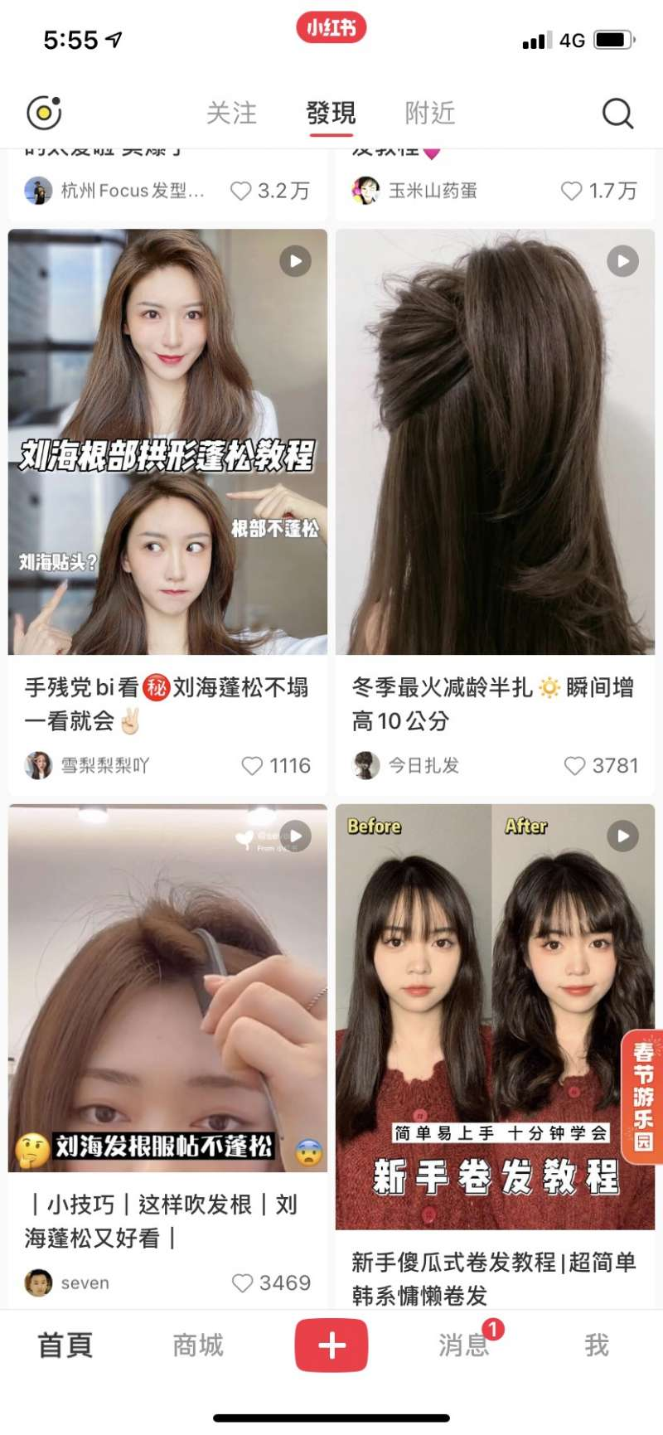

Slide 24
Why Xiaohongshu is so popular? How does it differ from Instagram?
5.Tutorial-focused videosContent, influencer experts in one minute "Guaranteed teaching"
Often you see things like "Hair braiding tutorial for beginners"、"Guaranteed teaching"This type of video content.
The photographer often plays the role of a teacher or professional.Share with your audience in the simplest and most interesting way within one minute,
Helps to cultivate "Internet celebrity experts" in this field

Slide 25
Why Xiaohongshu is so popular? How does it differ from Instagram?
6.Amateurs are Internet celebrities: It is easy to increase the number of fans because the tags will automatically push similar topics and are easy to be seen.
Due to the Little Red Book ClubAutomatically extend recommended topics, so even if you don't follow this tag,Posts still have a chance to be seen by other groups.
andIGAlthoughThere is also a labeling function.butAlgorithm tends to be exposedPopular Posts,It is not easy for a novice internet celebrity to become famous.
Xiaohongshu is more beneficial to beginnersCultivation

Slide 26
Why Xiaohongshu is so popular? How does it differ from Instagram?
7.Manufacturers use Internet celebrities to create "mall" benefits
There is a "mall" in XiaohongshuFunctional and popular, many manufacturers will contact well-known Xiaohongshu "bloggers" in the field to cooperate before launching their products, and let the bloggers shoot corresponding videos or publish texts for promotion.This product can be purchased directly in the "Mall" area of ​​​​Xiaohongshu
IGStill using
The old algorithm recommends products.
And can onlySingle theme products appear.
And the linked products cannot be directlyIGBuy on
thereforeIGMore like:Single product display area,
Xiaohongshu is:Large shopping mall

Slide 27
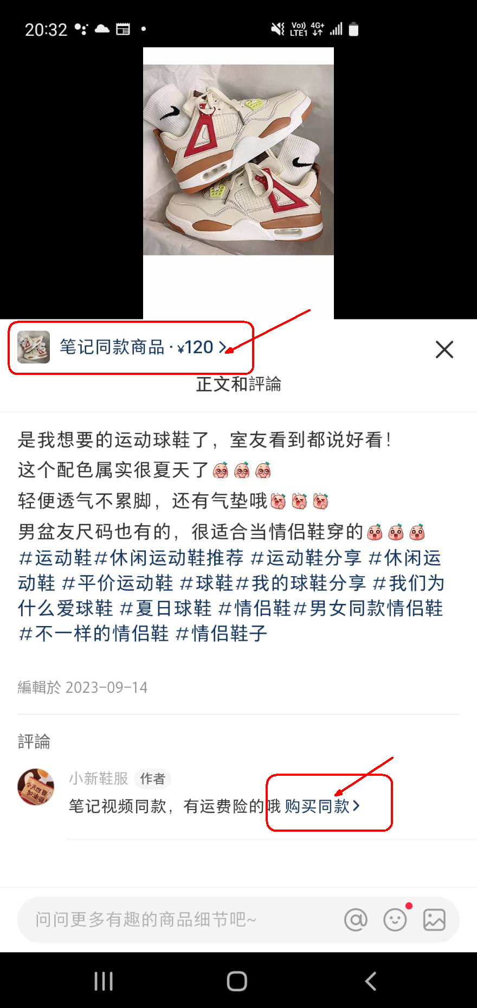
Xiaohongshu's unique integration of social networking and e-commerce
Internet celebrityUGCRecommended product articles
The product will be attached in the Xiaohongshu store.Hyperlink URL
Click directly to purchase the same product

Slide 28
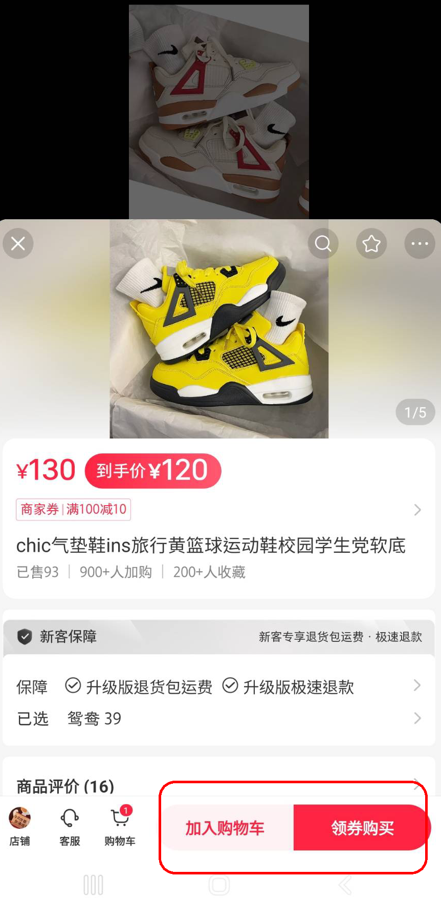
Xiaohongshu's unique integration of social networking and e-commerce
Click directly to purchase the same product

Slide 29
Differences between Xiaohongshu and other social media platforms
(1).Little Red Book:
It is the current social media platform.The only one with a built-in mall,
Watch Internet celebritiesRecommended ArticlesLinks, thenBuy the same product directlyof
(2).OtherTiktok,Ffacebook,IInstagram,Youtubewaitplatform
although,TitlehaveshoppingFunction,
butBothLinks to external e-commerce,
It is not a trading platform within the platform

Slide 30
How to use Xiaohongshu in Taiwan
How to register a Xiaohongshu account in Taiwan in three simple steps?
https://www.youtube.com/watch?v=AJiQZS5zVA4
Can be usedTaiwan(+886)Mobile phone registration login
You can also useLogin with WeChat account

Slide 31
4.Several issues with using Xiaohongshu in Taiwan

Slide 32
1.Do all products on Xiaohongshu's mall ship from mainland China? Are there any products that ship from Taiwan?
1.Xiaohongshu’s mall:
Most of the products are shipped from mainland China.
There is currently no clear information showing that there are products shipped locally in Taiwan.

Slide 33
2.Can Taiwanese buy mainland products in the mall?
2.Taiwan purchases mainland products:
Taiwanese users can purchase mainland products on the Xiaohongshu mall.
But you need to useConsolidation ServiceShipping products from China to Taiwan(Like the method of purchasing Taobao products in the early days)
This usually involves
After purchasing products on Xiaohongshu,
Delivery addressSet toShipping warehouse address,
Then fromShipping warehouseShipped to Taiwan.

Slide 34
2.Can Taiwanese buy mainland products in the mall?
2.Taiwan purchases mainland products:
If you don't know how to useConsolidation ServiceShipping products from China to Taiwan.
There is a purchasing agent on Shopee
https://www.xiaohongshu.com/explore/65533b32000000001b035706?app_platform=android&ignoreEngage=true&app_version=8.11.10&share_from_user_hidden=true&xsec_source=app_share&type=video&xsec_token=CBSZkJIohXqZCuxxkA5CW8O8Vxl1psK m4fn2uqu757TtI=&author_share=1&xhsshare=CopyLink&appuid=611e50190000000001003421&apptime=1724178191

Slide 35
3.Do you need a mobile phone to read Xiaohongshu app, is there a web version?
Yes, there is a web version(But only some functions are supported)
Select Login and theQR Code
Use yourLog in by scanning the QR code on your mobile phone
The premise is that your Xiaohongshu must have【Settings】Your phone/password
After setting, use WeChat to scan and log in to the web page.QR code
You can use the web version of Xiaohongshu

Slide 36
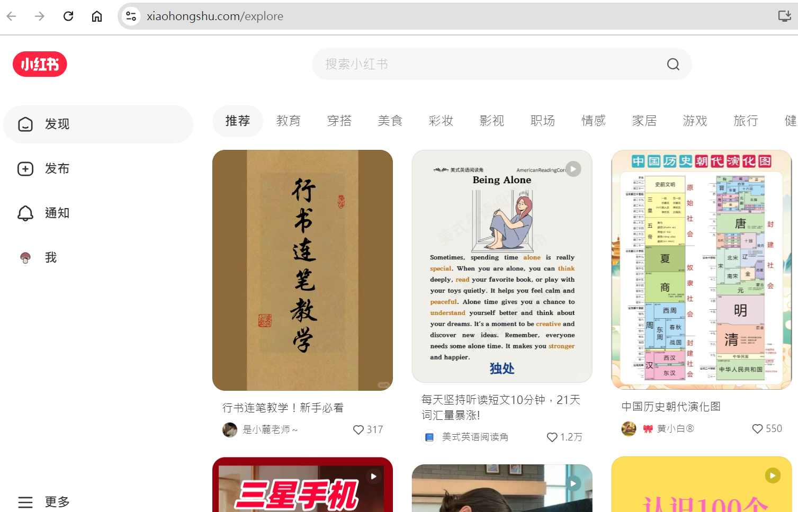
Xiaohongshu, web version, after logging in

Slide 37
4. The current usage of Xiaohongshu in Taiwan
The basic algorithm for Xiaohongshu's traffic recommendation system

Slide 38
4. The current usage of Xiaohongshu in Taiwan The basic algorithm for Xiaohongshu's traffic recommendation system
Getting Started! A Complete Guide to Xiaohongshu【Professional accounts, advertising, and internet celebrity collaborations】
problem:
Do brands need to operate Xiaohongshu themselves?
Or should we just hire influencers to recommend products?
https://youtu.be/9hTJBGmEDPs?t=70

Slide 39
Why would Xiaohongshu recommend an article with the hashtag "football" to me?
Causes may include the following5point:
1.Interest Analysis:
Xiaohongshu analyzes yourView history, likes, favorites, and shared content,To guess your interests.
2.Hot Topics:
If "football" is the current hot topic, Xiaohongshu may recommend related articles to more users.even thoughYou don't haveInterest.

Slide 40
Why would Xiaohongshu recommend an article with the hashtag "football" to me?
3.Diversity Recommendations:
Xiaohongshu's algorithm may recommend you content that is different from your usual interests.Provide moreDiversityThe reading experience allows youHave the opportunity to be exposed to different topics.
4.Influence of friends or social circles:
If you areFriends followed on Xiaohongshuor yourSomeone in your social circle shows interest in football, the platform may also recommend relevant content to you.
5.Advertising:
someHashtagarticleMaybe it's a paid promotion by the brand, the algorithm will push these contents to more users to increase exposure

Slide 41
Why have Chinese apps like TikTok/Xiaohongshu become popular worldwide?
WhyTikTok I have lived in the United States for a long time.APPAre they the top three downloads?
WhyTikTokWill it make the United States want it to be acquired by American companies or removed from the shelves?
That's becauseTikTok Have itMy own uniquePush traffic algorithm,
This is itThe key and secret to successful business operation
There is more than one algorithm.

Slide 42
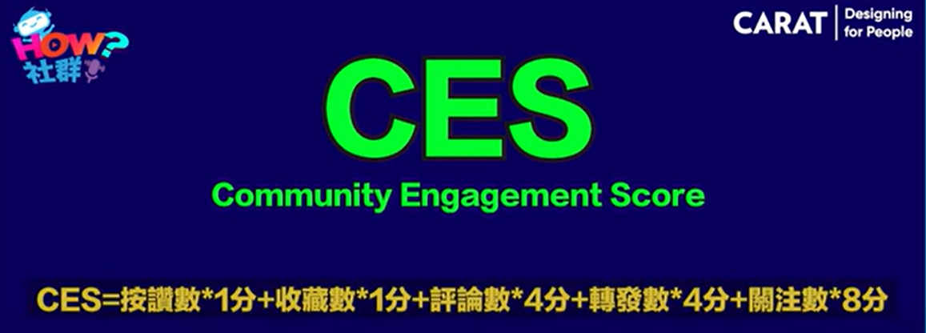
One of the key mechanisms in Xiaohongshu's recommendation algorithm is whether an article or video will be recommended by the system
Related parameters:
Like1, number of favorites1, number of comments4, number of followers8
First test in a small flow pool. If the score is high, proceed to the next large pool.

Slide 43
How can I make it easier for users to see my articles or videos when they search for keywords?
XiaohongshuhuiuserEnter keywords, create a list, and sort by score
Factors Affecting Ranking Score1:
The closer to the keyword, the higher the ranking score
Factors Affecting Ranking Score2:
Someone discussed in the comments section,The more comments you have, the higher your ranking score will be.

Slide 44
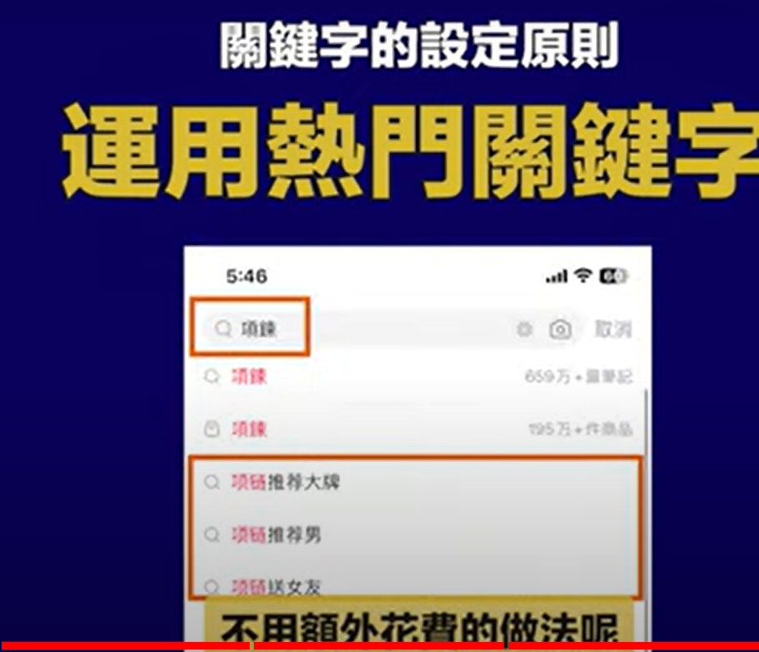
How can I make it easier for users to see my articles or videos when they search for keywords?
Set up your【article/Film】The keywords become very important:
method1:use【Hot Keywords】
that is【Search List】Keywords in

Slide 45
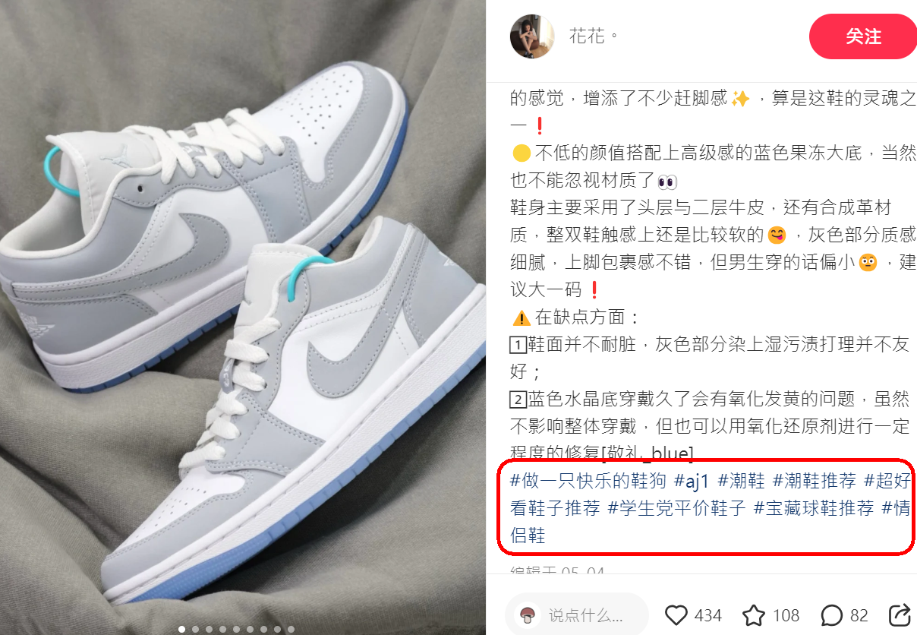

Slide 46
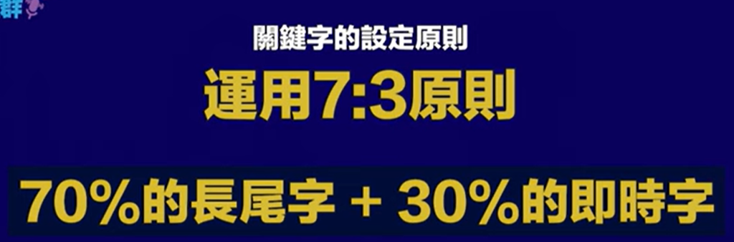
How can I make it easier for users to see my articles or videos when they search for keywords?
method2:use【7:3】Combination of keywords
70%Long tail word(Main keywords)+30%Real-time hot words
Keywords: chocolate, Valentine's Day
Keywords: whitening, double11Must buy

Slide 47
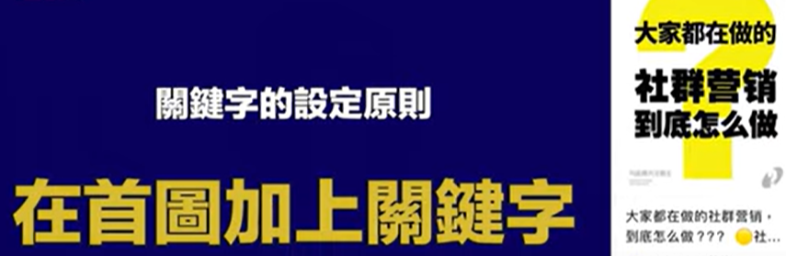
How can I make it easier for users to see my articles or videos when they search for keywords?
method3：Add keywords to the first picture
existHome page header image,abovePlusSlogan(Keywords)
Can increase the chance of being recommended by system traffic

Slide 48
How can I make it easier for users to see my articles or videos when they search for keywords?
method2:use【7:3】Combination of keywords
70%Long tail word(Main keywords)+30%Real-time hot words
Keywords: chocolate, Valentine's Day
Keywords: whitening, double11Must buy

Slide 49
Other Successful Case Analysis
Perfect Diary:
platform:WeChat, Weibo, Xiaohongshu Strategy: Perfect Diary UtilizationKOLThrough social media promotion with influencers and precise content marketing and social e-commerce activities, it has quickly become a leading beauty brand in the Chinese market. result：The brand quickly attracted a large number of young consumers and successfully achieved multi-channel sales.

Slide 50
Other Successful Case Analysis
Glossier:
platform:Instagram Strategy：Glossier has successfully built a cosmetics brand popular among young women by emphasizing real consumer experience through user-generated content (UGC) and collaboration with influencers. result：Glossier’s brand value has increased rapidly, becoming one of the successful examples of social commerce.

Slide 51
5. Which social media platforms integrate both social interaction and online shopping features?

Slide 52
5. Which social media platforms combine social interaction with online shopping features?
Instagram:
InstagramProvides rich social interaction features, including photo and video sharing,Instagram Stories,Reelswait.
ThatShopping function (Instagram Shopping) Allow merchantsTag products in posts and stories, and directly through the shopping tabLink to shopping page, users can purchase products directly on the platform.
Facebook:
FacebookIt provides a variety of social interaction functions such as communities, personal dynamics, and live broadcasts.
Facebook MarketplaceandFacebook ShopsAllowing businesses and individuals toDisplay and sell products on the platform, users can conduct transactions directly.

Slide 53
5. Which social media platforms combine social interaction with online shopping features?
TikTok:
TikTok It mainly uses short videos and has powerful social interaction functions.
TikTokShoppingAllow brands and creatorsEmbed product links directly into video content, and provide live shopping function, users can shop while watching the live broadcast.
Little Red Book (Xiaohongshu):
Little Red BookCombining social media and e-commerce capabilities, through user-generated content (UGC) to recommend and share products.
Users can view product notes within the platform and purchase products directly through embedded shopping links.

Slide 54
5. Which social media platforms combine social interaction with online shopping features?
WeChat(WeChat):
WeChat combines social, payment and e-commerce functions, and provides social interaction functions such as chatting and sharing in Moments.
Its built-in mini-programs and WeChat payment functions allowUsers can shop and pay directly on the platform, especially in the Chinese market.
Youtube:
YoutubeMainly video content, with extensive social interaction features such as subscribing, commenting, liking and sharing.
YouTube ShoppingAllow creatorsEmbed product links in videos, and sell goods directly through live streaming.

Slide 55
5. Which social media platforms combine social interaction with online shopping features?
Pinterest:
PinterestIt is mainly based on sharing images and inspirations, and has collection, sharing and social interaction functions.
Its shopping function (Pinterest Shopping) AllowMerchants inPinsWinning bid products, users can directly click to purchase.

Slide 56
Facebook Shops

Slide 57
Facebook Store is basically free
existFacebook Marketplacesuperior,FacebookNo commissions charged on most trades
This means that sellers canList and sell items for free,
This is one of the reasons why many people choose to sell second-hand items here.
Avoid fees:Unlike other online markets,Facebook MarketplaceNo fees for sales. This makes it a cost-effective choice for sellers.

Slide 58
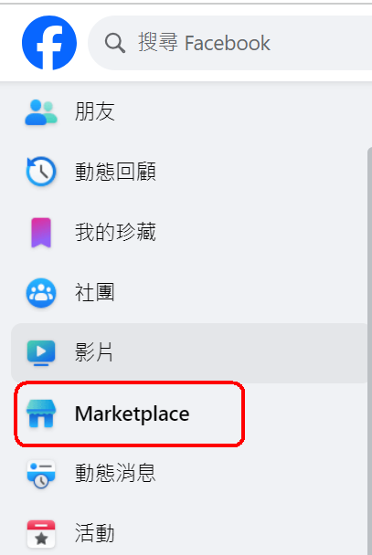
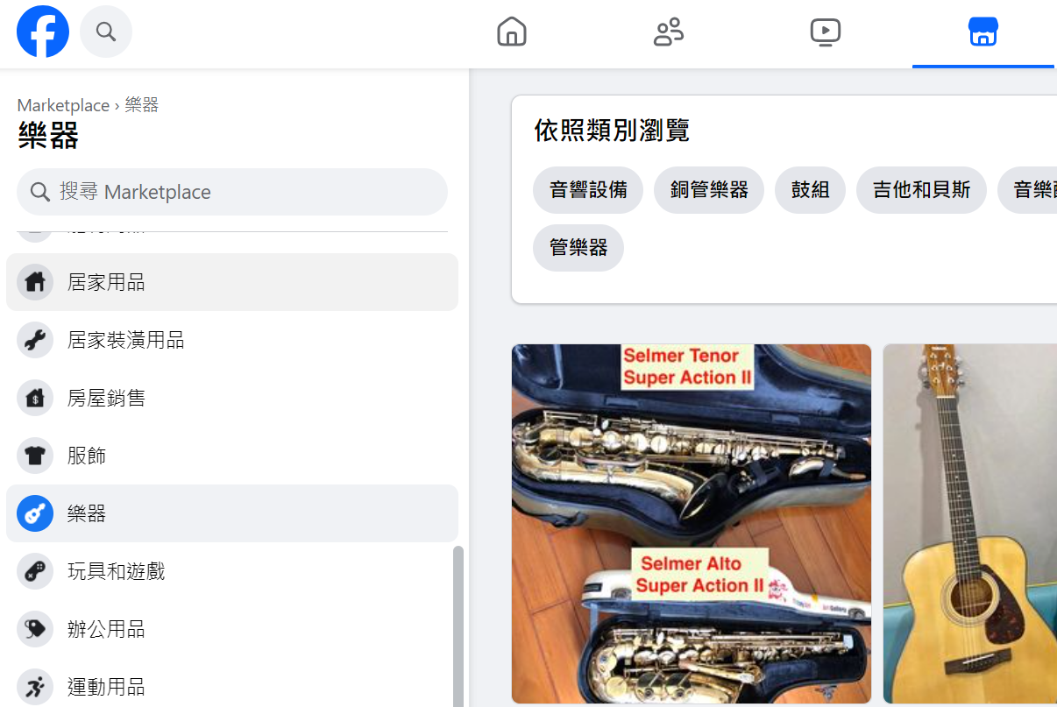
Facebook Shops

Slide 59
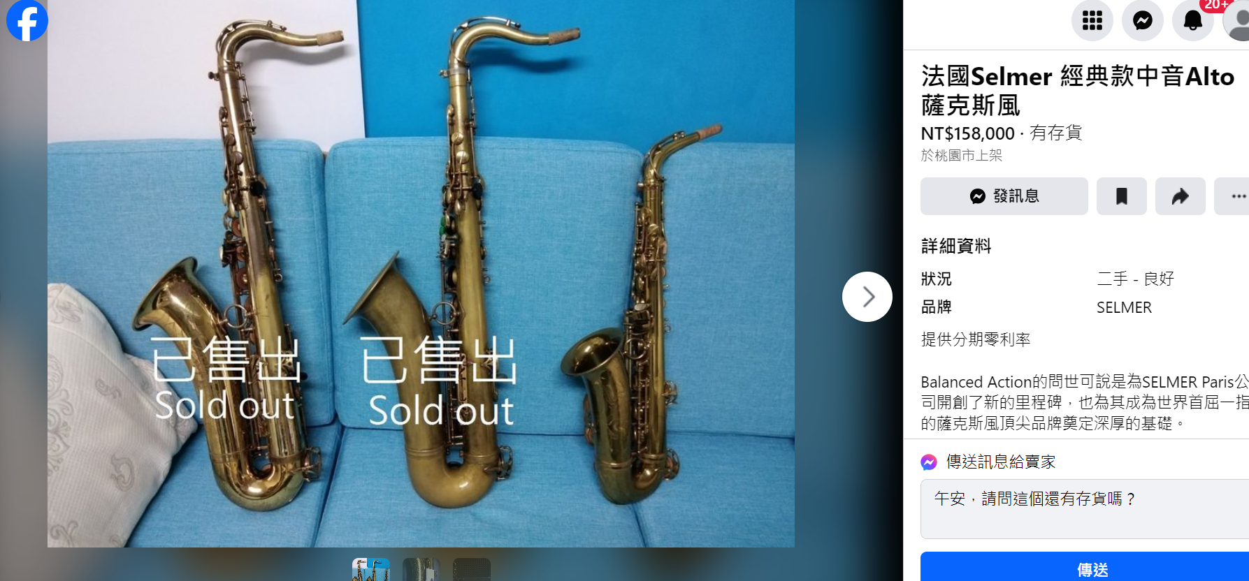
Facebook Shops

Slide 60
Google Shopping

Slide 61
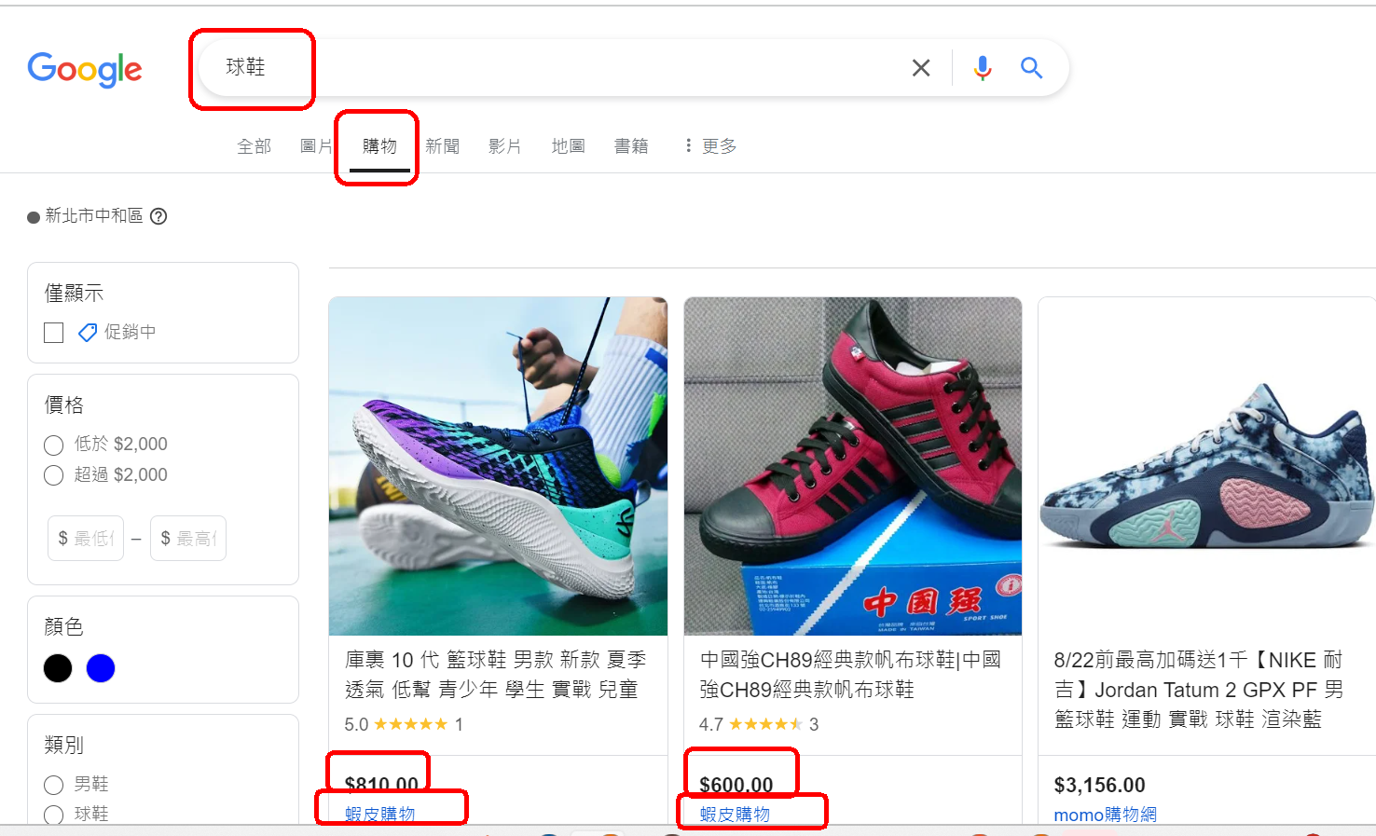
Google Shopping
GoogleShopping isGoogleSearch Engines

Slide 62
Google Shopping
GoogleShopping isGoogleSearch Engines
feature1: All are linked to【External e-commerce】platform
feature2：Can be regarded as【Price Comparison】A new choice for
Although currentlyGoogle ShoppingCan be searchedThere are still not many stores.
GoogleThe drainage effect is very good.
Why hang on【GoogleShopping】There aren't many products?
Why?

Slide 63
Google Shopping
Why hang on【GoogleShopping】There aren't many products?
Because:placeProducts inGoogle ShoppingyesTo be paid
(1).If someoneClickMerchant's website
(2).Directly on the websiteBuyHour,
Merchants must payGoogle

Slide 64
Youtube Shopping
Tagging Products in Videos, Live Streaming for Sales

Slide 65
Youtube Shopping Tagging Products in Videos, Live Streaming for Sales
Integrated shopping experience:
Allow viewers to easily browse and purchase products while watching videos.
Product Information Card:
A product information card will be displayed during video playback.
Contains information such as product pictures, prices, and product descriptions.
Product Link:
Visitors can click on the link on the product information card.
Go directly to the product page of the relevant shopping platform to make a purchase.

Slide 66
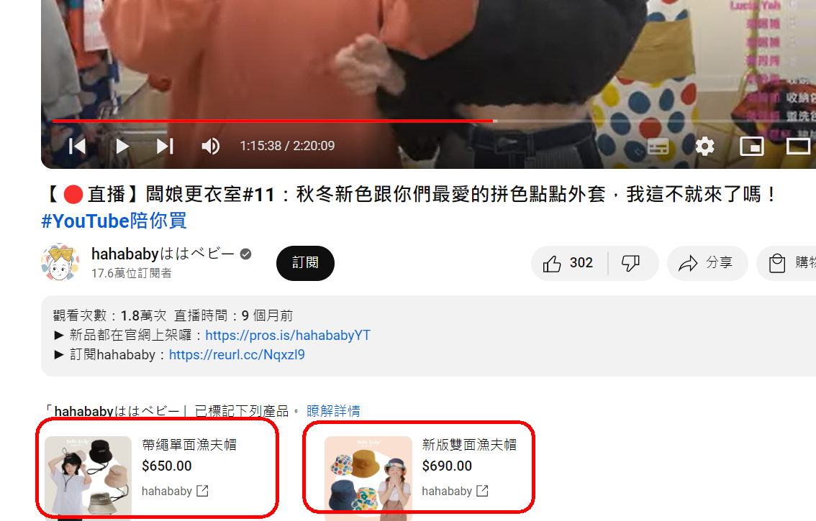
Youtube Shopping Tagging Products in Videos, Live Streaming for Sales
New autumn and winter colors and your favorite color-blocked polka-dot jackets
https://www.youtube.com/watch?v=Kotv9ln-3Fg&list=PLPh89N96p447xu4fBpJKapUiwPJ7A7Nok&index=5

Slide 67
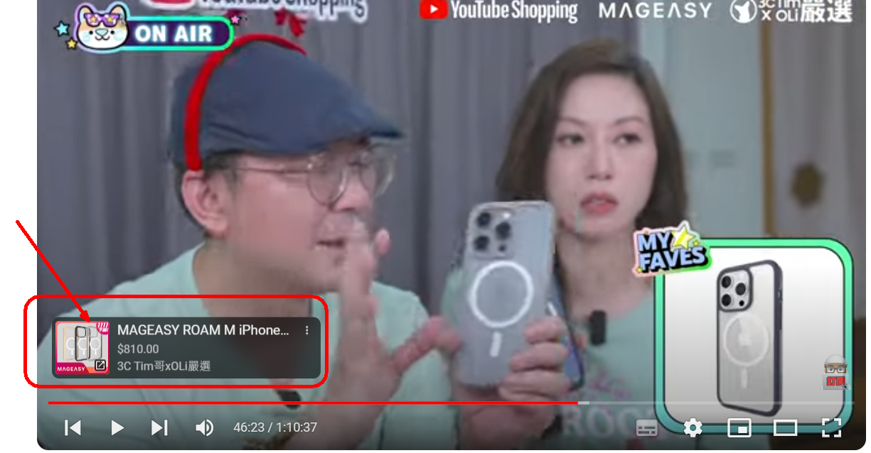
You can also directly mark the link of the product in the video
https://youtu.be/RJus4obV2pU?list=PLPh89N96p447xu4fBpJKapUiwPJ7A7Nok&t=2783

Slide 68
IG shop

Slide 69
IG Shopping function
IGShopping, also known asIGshop,yesInstagramAn e-commerce feature on
Allow users to one-stopIGPurchase items on .
This feature was added in2020Yearroll out,It caused a heated response at the time
Many experts at the time also estimated:IGandFBThis move is undoubtedly an attack on the e-commerce market and will bring new business opportunities to social e-commerce.

Slide 70
Taiwan has not been able to use IG shop
butfromIGSince the launch of the shopping mall, Taiwan has alwaysUnableUse financial and logistics services:
That isCannot be directlyIGCheckout, purchase goods.
SellerCan onlyIGStores as "product catalogues",
Consumers must also【By link,Private Message】to purchase the product.
therefore,IGShopping/IGStores in TaiwanIGIt is not of much practical help to creators, business accounts or sellers.

Slide 71

After the 2023 update, IG Shopping/IG Shop has disappeared from the shortcut bar.
IGThis meansIGfutureMore focus on the creator,letCreators can betterCreate your own personal content,
existYoutube andTikTok Under the influence of video platforms,
Hope this will update you.Preventing creators from leaving

Slide 72
The future direction of IG: Separating IG from e-commerce shopping to maximize the potential of each platform.
Future direction: diversion
letIGAccount:responsibleAttract more followers and exposure;
E-commerce sales：Leave it to a more professional e-commerce businessOfficial Online Store(handleFinancial Logistics)
Community operators can gain exposure and traffic through content, and then direct some of the traffic to the official website store or product page.
IGofficial:Encourage users toIGHomePut your own website link,

Slide 73
6.Current trends in social media e-commerce:
traffic diversion

Slide 74
Current trends in social media e-commerce: traffic diversion
Apart fromLittle Red BookBeyond,
Other social media platforms are trending towards:Shunt
Social media, focus on encouragementuserCreate content,
As for the sale of goods, it is handled by professional e-commerce platforms.【Financial flow, logistics】
Diversion processing:
Instagram,Facebook, TikTok,Youtube

Slide 75
Another type of social media e-commerce development: Group Buying
Group Buying PostsThe largest number of platforms areFacebook,Instagram
More and more people are starting toIGJoin a group tour and purchase products.
Follow your favoritesKOL/Internet Celebrities/Group LeaderGroups
orDirect participationLimited time offerGroup purchase price
IGWith Group BuyingThe relationship between them can be said to be getting closer and closer.

Slide 76
Five methods for e-commerce development on social media platforms like IG.
Steps1: RequiredPossessionYour own website store(existIGOutside the store)
Steps2:ManagementSocial Media(IGCommunity), often publishedUGC,Accumulated fan base
Steps3:Direct fans to the official shopping websitePlace an order
IGPersonal Profile:placeOfficial website link,
IGLimited movement：Use superLinks,Put a one-page web page,
Operate official website members,
Internet celebrity profit sharing,
Organize group buying activities

Slide 77
Shein's approach on social media platforms and with influencers.

Slide 78
Case Study: Shein
Special performance:
Sheinfrom2021The year begins.All AmericaAPPDownloads1name
Sheinexist54A country, tooAPPDownloads1name
SheinexistFashion/ClothingCategoryInternet traffic is the world's1name
VisitSheinWebsiteAverage length of stayfor8point36Seconds (higher than other brands）
from2013Year starts8Year,The annual growth rate exceeds100%
A business philosophy that is better than competitors:
1.SheinalreadyBeyond【Fast Fashion】, but【Instant Fashion】
2.SheinIt's like【E-commerceTikTok】 ➜gooduse【Big Data Analysis】Gain insights into customer preferences and market trends

Slide 79
Case Study: Shein
A business philosophy that outperforms competitors:
3.SheinIt is the first【Internet Celebrities/KOL】To recommend products (in2010Years ago)
Social Media【FB,Instagram,twitter】Combine【Internet celebrities,KOL】To promote products
Large-scale recruitment【Sheingirl】
ROI of influencersROIfor1:3, very profitable

Slide 80
What is Return on Investment (ROI) = 1:3?
Shein ROI of influencers (ROI)for1:3
This means that every investment1The unit's funds,Shein You can gain from these Internet celebrities3Unit revenue.
In other words,
Shein Every dollar invested in influencer marketing,AllCan generate three returns

Slide 81
Case Study: Shein
A business philosophy that outperforms competitors:
4.Sheinhave【Affiliate Program】,【Distribution】
It is the first【Internet Celebrities/KOL】To recommend products (in2010Years ago)
Social Media【FB,Instagram,twitter】Combine【Internet celebrities,KOL】To promote products
Large-scale recruitment【Sheingirl】
ROI of influencersROIfor1:3, very profitable
5. SheinLarge-scale online advertising (Google,FB,TikTok,Instagram
Using big data analysis toPrecise delivery, not just randomly placed

Slide 82
What is【Affiliate Program, Distribution】
【Affiliate Program】（Affiliate Program), that is【Distribution】plan,
Allows individuals or organizations to becomeShein Through the promotion ofShein To earn commissions from products sold by you.
Join the Affiliate Program:
Partner NeedsRegister and joinShein Affiliate ProgramAfter registration, partners will receive a unique referral link or code to track the sales they bring in.
PromotionShein product(Do you offer exclusive discounts?):
Partners canSocial media, blogs, websitesOther platforms for promotionShein Products.
They will shareShein ofProduct link or exclusive discount code, attracting their audience to make a purchase.
Now many Internet celebrities, in the advertisement【attachProduct link or exclusive discount code】, indicating that he participated【Affiliate Program, Distribution Program】

Slide 83
What is【Affiliate Program, Distribution】
3.Earn commission:
When consumersuse【Promotional Links,Code】existShein When shopping, partners will receiveA certain percentage of commission.
4.Commission Payment:
Shein Commissions are paid to partners periodically in accordance with the terms of the affiliate program. The method and timing of payment may vary and are determined byShein Affiliate Program Rules

Slide 84
Google Affiliate Program
YouTube ShoppingAffiliate Program
GoogleAffiliate Program
https://www.youtube.com/watch?v=k3NlQiF_yOY
Most of Taiwan's big internet celebrities have participated in the alliance program, participateDistribution Dividends,have2Alliance Plan:
Social Media PlatformsAffiliate Program
Factory OwnerAffiliate Program

Slide 85
7.User-generated content in social commerce (UGC）

Slide 86
Definition of User-Generated Content
User-Generated Content (UGC)
refers toContent created and shared by consumers, which includes product reviews, shopping experiences, photos and videos.
UGC is often widely disseminated on social media platforms and has a significant impact on other consumers' purchasing decisions.

Slide 87
The value of UGC in social commerce
IncreaseTaste Card credibility:
UGC comes from real consumers' usage experience and is therefore more persuasive than traditional advertising. It can enhance the credibility and appeal of a brand.
Increase participation:
By encouraging users to create and share content, brands can increase interactions with consumers, boosting brand loyalty and engagement.
Expand brand influence:
The widespread sharing of UGC on social media can quickly expand the brand's influence and attract more potential customers.

Slide 88
8.How to use UGC
for marketing

Slide 89
How to use UGC for marketing
Encourage users to share:
Brands can incentivize consumers to create and share brand-related content through promotions or social media challenges.
Showcase UGC:
Display UGC on the brand’s official website, social media accounts and advertisements to enhance consumers’ sense of engagement and trust.
Collaborate with creators:
Cooperate with UGC creators with a large number of fans to expand brand exposure through their influence.

Slide 90
Case Study: Starbucks’ #WhiteCupContest
Starbucks launched a campaign on social media#WhiteCupContest event,
Invite consumers toCreate artwork on white coffee cupAnd share.
This activity not only stimulated a large amount of UGC,
It also successfully increased the brand’s social influence and consumer engagement.

Slide 91
9.Conclusion

Slide 92
Conclusion
The rise of social commerce and influencer economy is redefining the future of e-commerce.
Through effectiveSeveral methods:
Using social media platforms,
The influence of Internet celebrities and KOLs,
and encouraging user-generated content,
Companies can reach their target audiences more accurately, increase brand awareness and sales. In this era where social interaction is at the core, companies need to constantly innovate and adapt to succeed in the fierce market competition.

